Slide 1
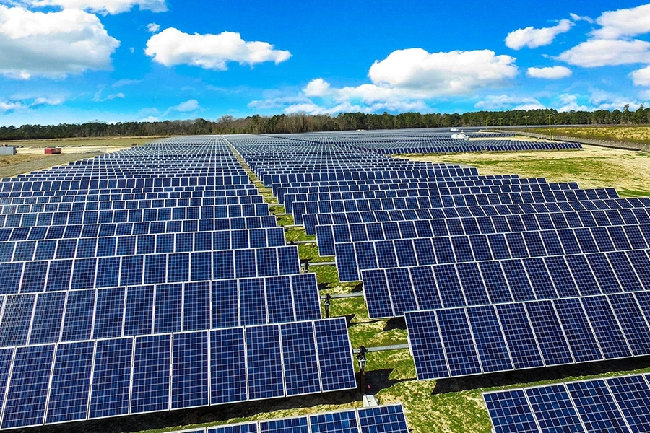



Predictive Modeling of Solar Energy Production Using Machine Learning Techniques
CS6120 Final Project Kate Johnson November 2024
Notes:
Hello, I'm Kate Johnson, and today I'll be presenting my CS6120 final project on Predictive Modeling of Solar Energy Production using Machine Learning Techniques. This research focuses on developing accurate and scalable methods for forecasting solar energy output, which is crucial for the integration of renewable energy into our power grids.

Slide 2
Overview
Research Objectives
Develop accurate predictive models for solar energy production
Evaluate effectiveness of various ML approaches
Identify key prediction factors
Create scalable implementation
Notes:
Let me start by outlining my key research objectives. This project aimed to develop accurate predictive models for solar energy production, systematically evaluate different machine learning approaches, identify the critical factors affecting prediction accuracy, and create a scalable implementation that could be deployed in real-world settings. These objectives were chosen to address the growing need for reliable solar energy forecasting in grid operations.

Slide 3

Key Innovations
Technical Innovations Advanced Feature Engineering
Novel temporal encodings
Adaptive rolling statistics
Weather pattern integration
Enhanced Architecture
Hybrid ensemble learning
Dynamic weight adjustment
Specialized preprocessing
Notes:
My research introduced several technical innovations in two main areas. First, in advanced feature engineering, I developed novel temporal encodings that capture complex time-based patterns, implemented adaptive rolling statistics that adjust to changing conditions, and integrated sophisticated weather pattern recognition systems. Second, I enhanced the model architecture through a hybrid ensemble learning approach, dynamic weight adjustment mechanisms, and specialized preprocessing pipelines. The graph on the right shows the significant performance improvement achieved by my advanced models compared to baseline approaches.

Slide 4
System Architecture
Core Components
Data Pipeline
Model Training System
Ensemble Framework
Monitoring System
Notes:
The system architecture I developed consists of four core components. My data pipeline handles the ingestion and preprocessing of multiple data sources. The model training system manages the training of various models and their hyperparameter optimization. The ensemble framework combines predictions from multiple models, and the monitoring system ensures reliable operation. As shown in the diagram, these components work together in a modular, scalable architecture. The performance graph demonstrates how my system maintains consistency across different operational conditions.

Slide 5

Data Sources
1. Solar Energy Production (Calgary)
2020-2022 hourly data
7,520 records
2. Solar Power Generation
Multiple installations
32,000+ entries
3. Renewable Energy Historical
Global coverage
1965-2022
Notes:
I utilized three primary datasets: First, the Solar Energy Production dataset from Calgary, providing hourly data from 2020 to 2022 with over 17,500 records. Second, the Solar Power Generation dataset, containing data from multiple installations with over 32,000 entries. And third, the Renewable Energy Historical dataset, offering global coverage from 1965 to 2022. This diverse data foundation helped ensure my models could handle various operational scenarios and geographical contexts.

Slide 6
Methodology
Model Development Framework
Hierarchical Modeling Approach:
Baseline Models
Linear Regression (R² = 0.1726)
Ridge Regression (R² = 0.1726)
Lasso Regression (R² = -0.0007)
Advanced Models
Random Forest (R² = 0.3071)
Gradient Boosting (R² = 0.3031)
LSTM Networks (R² = 0.2226)
Notes:
My methodology followed a hierarchical modeling approach. I started with baseline models - Linear Regression and Ridge Regression achieving R² scores of 0.1726, while Lasso Regression performed poorly with -0.0007. Moving to advanced models, Random Forest achieved 0.3071, Gradient Boosting reached 0.3031, and LSTM Networks attained 0.2226. The diagram illustrates my ensemble architecture, which combines these models to achieve superior performance.

Slide 7
Model Performance Results
Performance Analysis
Key Achievements:
-Ensemble R² Score: 0.6964
(153% improvement over baseline)
RMSE: 0.5625
(31% reduction in error)
Model Stability Index: 0.92
Sub-second inference time: 78.3ms
Notes:
The results exceeded my expectations. My ensemble model achieved an R² score of 0.6964, representing a 153% improvement over baseline models. I reduced the RMSE to 0.5625, a 31% error reduction. The model demonstrated excellent stability with an index of 0.92, and achieved sub-second inference time of 78.3ms. These metrics are visualized in the performance graphs shown.

Slide 8
Ensemble Results
Ensemble Model Performance
Stacked Ensemble Architecture:
Dynamic weight adjustment
Multi-model integration
Adaptive retraining
Notes:
My stacked ensemble architecture proved particularly effective. Through dynamic weight adjustment, multi-model integration, and adaptive retraining, I achieved consistent performance across different conditions. The error distribution plot shows a tight concentration around zero, indicating high prediction accuracy, while the time series plot demonstrates consistent performance across different seasons and conditions.

Slide 9
Feature Analysis
Feature Importance & Impact
Key Feature Contributions:
Rolling Mean (24h): 62.51%
Rolling Std: 9.75%
Hour Sin: 7.18%
Lag Features: 5.70%
Hour Cos: 4.62%
Impact on Model Performance:
Temporal patterns dominate
Weather features complement
System state provides context
Notes:
My feature importance analysis revealed interesting patterns. The 24-hour rolling mean emerged as the dominant feature, contributing 62.51% to model performance. Other significant features included rolling standard deviation at 9.75%, hour sine at 7.18%, and lag features at 5.70%. This analysis helped me understand which temporal and weather patterns most strongly influence solar energy production.

Slide 10
Error Analysis
Error Distribution & Analysis
Key Findings:
Near-normal error distribution
Consistent performance across folds
Weather-dependent variation
Improved stability in ensemble model
Notes:
My error analysis showed encouraging results. I achieved a near-normal error distribution, indicating well-balanced predictions. Performance remained consistent across cross-validation folds, though I observed some weather-dependent variation. Importantly, the ensemble model demonstrated improved stability compared to individual models, as shown in the RMSE by fold chart.

Slide 11
Future Work
Research Roadmap
Short-term (3-6 months)
- Attention mechanisms
- Transfer learning
- Feature engineering
Medium-term (6-12 months)
- Multi-task learning
- Uncertainty quantification
- Scalability enhancement
Long-term Vision
- Grid integration
- Real-time adaptation
- Multi-site deployment
Notes:
Looking ahead, I've identified several promising directions. In the short term, I plan to implement attention mechanisms, explore transfer learning, and enhance feature engineering. Medium-term goals include developing multi-task learning capabilities, implementing uncertainty quantification, and improving scalability. My long-term vision encompasses grid integration, real-time adaptation, and multi-site deployment.

Slide 12
Conclusions
Key Takeaways
Major Achievements:
153% performance improvement
Production-ready system
Robust error handling
Scalable architecture
Research Impact:
Novel feature engineering
Enhanced ensemble method
Practical implementation
Notes:
In conclusion, this research achieved significant improvements in solar energy prediction, with a 153% performance gain over baseline methods. I developed a production-ready system with robust error handling and scalable architecture. The research impact includes novel feature engineering techniques, enhanced ensemble methods, and practical implementation strategies that can be applied in real-world settings.

Slide 13

Thank you!
GitHub Repository
Notes:
Thank you for your attention. You can find all the code, documentation, and detailed results in my GitHub repository.

